Slide 1
Introduction to General Pharmacology (OPT328)

Slide 2
Course Outline
Introduction to Pharmacology
Drug Nomenclature
Routes of administration
Pharmacokinetics
Absorption
Bioavailability
Distribution
Body compartments
Volume of distribution
Phase 1 and 2 Metabolic reactions
First-pass metabolism
Excretion

Slide 3
What is Pharmacology
Pharmacology is the science of drugs and their effects on living systems.
It involves the study of the physical and chemical properties, biochemical and physiological mechanisms of action, therapeutic and adverse effects of drugs
Scientific study of how drugs affects man and how man affects drugs
Drugs used in the effective and safe prevention, diagnosis , treatments of diseases as well as the maintenance of health are studied in Clinical pharmacology.

Slide 4
Branches of pharmacology
Pharmacology has two major branches:
Pharmacokinetics – This describes the motion of drugs through the living system and the activities as it moves through the body. These activities include absorption, distribution, metabolism, and excretion of drugs. This branch of pharmacology is also concerned with a drug’s onset of action, peak concentration level, and duration of action. (how man affect the drug)
Pharmacodynamics – Pharmacodynamics deals the changed that occur in the structure and functions of the living system as a result of the drug. It involves the study of molecular, biochemical, and physiological effects of drugs, including drug mechanism of action. In simplest terms, it can be described as what the drug does to the body. (how drugs affects man)
Others branches of pharmacology include clinical pharmacology, toxicology, neuropharmacology, psychopharmacology, pharmacotherapeutics, pharmacogenetics, pharmacogenomics, toxicology, chemotherapy, posology, pharmacoeconomics, pharmacoepidemiology, molecular pharmacology, immunopharmacology, pharmacometrics etc.

Slide 5
What is a drug
Any substance or product which brings about change in the structure and or functions of the living system., i.e. when administered to a living organism, influences biological functions.
A substance that is used or intended to be used to modify or explore physiological systems or pathological states for the benefit of the recipient.

Slide 6
Drug Nomenclature (Naming of drugs)
Chemical name
Technical and exact description of the chemical makeup of the drug and indicates the arrangement and position of atoms or atomic groups. e.g., 1-Cyclopropyl-6-fluoro-4-oxo-7-(piperazin-1-yl)-1,4-dihydroquinoline-3-carboxylic acid Hydrochloride.
Generic name
This is the name with which the drug is described in official books of reference like pharmacopoeias e.g., ciprofloxacin.
Brand name
This is the name given to a drug by its manufacturer. This name is often followed by the symbol ® which indicates that the name is registered to a specific manufacturer and no one else can use that name. Examples include Panadol®, Ciprotab®, Neofloxin® etc.

Slide 7
CLASSIFICATION OF DRUGS
Source (Natural, Semi-synthetic, Synthetic)
Chemical Nature (organic and Inorganic)
Target organ/Site of Action (Drugs acting on GIT, CNS, Ocular etc)
Mode of Action
Therapeutic Uses (Antimicrobials, Antihypertensives, antiglaucoma, etc)
Physiological (Sympathetic , Parasympathetic, etc)

Slide 8
Routes of drug administration

Slide 9
Pharmacokinetics
The concentration of drug in the plasma depends on the rate at which drug molecules move from site of administration to blood stream, this is determined by rate of drug
Absorption
Distribution
Metabolism
Elimination
Pharmacokinetics is currently defined as the study of the time course of drug absorption, distribution, metabolism, and excretion.

Slide 10
Pharmacokinetic processes
Absorption: Movement from admin site to systemic circulation. For IV dosing there is direct delivery in the systemic circulation means that 100% of the drug is available)
Distribution: Movement of the drug into the tissues
Metabolism: changing the drug into other molecules i.e. breakdown of the parent drug into metabolites
Excretion: Removal drug and associated metabolites from the body
It is important to note that pharmacokinetic analysis is not usually limited to the parent drug molecule itself, but also identified metabolites.

Slide 11
Drug absorption
The process by which drugs enter the blood stream without being chemically changed
For a drug to be absorbed, it must move from the site of administration, into systemic circulation, therefore it must cross several membranes.

Slide 12
Drugs cross biological membranes via one or more of the following mechanisms:
• Passive Processes
• Active Transport
• Facilitated Diffusion
• Endocytosis

Slide 13
Passive processes
Movement of drug molecules from an area of higher concentration to area of lower concentration.
Directly proportional to conc. gradient.
Two types
Passive diffusion: Movement by dissolution in the cell membrane.
Passage through the water channels.

Slide 14
Active transport
Movement is against a concentration gradient
Energy is expended (ATP)
Carrier molecules be required
Carriers exhibits structural selectivity, saturability, competition between structural analogues and genetic variants.

Slide 15
Characteristics of Active Transport
movement occurs against a concentration gradient.
rate is proportional to drug concentration only when the carrier is not saturated.
specificity for a particular type of chemical structure.
occurs from a specific site in a limited segment of the small intestine.
competitive inhibition for structurally similar substrates transported by the same transport mechanism
Obeys Michaelis-Menten kinetics: if drug concentration is high enough to saturate carrier mechanism, kinetics are zero-order (rate of transport is constant).

Slide 16
Facilitated Diffusion
Carrier dependent
Movement is from an area of higher concentration to area of lower concentration.
No energy required

Slide 17
Endocytosis
Passage into cell within membrane invagination.
Important mechanism for particulates and high molecule weight compounds, such as proteins.

Slide 18
Factors that influence rate of drug absorption
Route of administration
Type of transport
Concentration of the drug
Physiochemical properties of the drug ( Dissolution into aqueous fluids at absorption site, lipid solubility, etc.)
Circulation to the site of absorption

Slide 19
Factors that determine passage of drugs across membranes
lipid solubility of the drug (Lipid water partition coefficient)
Lipid water partition coeff. = conc. of drug in lipid conc. of drug in water
The higher the partition coefficient, the more lipid soluble the drug is, the easier it is for the drug to cross membranes
Most lipid-soluble drugs pass through biological membranes by simple diffusion.

Slide 20
Charge of molecules (Degree of ionization)
For absorption to occur, drugs must be dissolved in aqueous fluid.
Most drugs exist as week acids or weak bases and as such can be ionized in solution. The ionized form of the drug is in equilibrium with the unionized drug. Only the unionized form can cross cell membranes easily
The degree of ionization is influenced by
PH of the medium
Pka of the Drug (Dissociation constant)

Slide 21

The relationship between PH and Pka is expresses as Henderson-Hasselbalch Equation

Slide 22
Distribution of drugs
Movement of drug molecules to site of action
Factors Influencing Drug Distribution
physiochemical characteristics of the drug
lipid solubility of the drug
Charge of drug molecules
Drug Reservoirs
Plasma proteins
Binding of drugs to intracellular sites
Binding of drugs to Adipose tissues

Slide 23
Plasma protein binding
Many drugs reversibly bind to albumin, α1-acid glycoprotein or other proteins in plasma;
The extent of binding is dependent on affinity, number of binding sites, and drug concentrations;
drug bound to proteins is not filtered by renal glomerulus but may be cleared by proximal renal tubule and liver;
binding reduces free drug available for distribution into tissue;
many drug interactions based on displacement from binding sites.

Slide 24
Factors Influencing Drug Distribution contd
Blood flow: distribution occurs most rapidly into tissues with high blood flow (lungs, kidneys, liver, brain) and least rapidly in tissues with low flow (fat).
Capillary permeability: permeability of capillaries is tissue dependent; distribution rates relatively slower into CNS because of BBB
Apparent Volume of Distribution (V^{d})
1. Fluid compartments of 70-kg subject in liters and as percent of body weight: plasma 3 l (4%), extracellular water 12 l (17%), total body water 41 l (58%).
Vd = Dose given / Initial plasma concentration

Slide 25
Distribution across blood-brain barrier
CNS capillaries are not fenestrated, they have tight junctions
CNS capillaries are surrounded by astrocytes
Limited interstitial spaces
resists the movement of water-soluble and
ionized drugs into CNS
CSF proteins do not function as drug reservoirs

Slide 26
Distribution across placenta
Placenta is highly permeable to drugs
Distribution primarily by simple diffusion
Nutrients, as wells as drugs of abuse (e.g., alcohol, cocaine), readily cross placenta

Slide 27
Drug Metabolism
Process by which body transforms drugs from one form to the other.
Change in chemical structure by spontaneous or (more usually) enzymatically catalyzed reaction
Products are called metabolites
Products generally have lower biological activity
Products are usually more polar, facilitating renal excretion
Primary site of biotransformation is the liver

Slide 28
Product(s) may have greater, lesser or qualitatively different pharmacologic activity from parent compound.
A prodrug is inactive and is biotransformed to a therapeutic agent.
Reaction rate dependent on chemical structure and obeys Michaelis-Menten kinetics (usually first-order at therapeutic drug concentrations).
Enzymatic activity generally highest in liver;

Slide 29
Types of metabolism
Two major categories:
phase I or non-synthetic and
phase II or synthetic
phase I or non-synthetic
Oxidation, reduction, hydroxilation
phase II or synthetic or conjugation
Synthesis of a macromolecular which reacts with original drug or its phase 1 metebolite

Slide 30
Effects of Drug metabolism
Renders the drug more hydrophilic, thus enabling excretion by the kidneys.
Renders drug less active (in most cases)
Site of metabolism
Main site is Liver, esp. the smooth endoplasmic recticulum of the liver which contains the hepatic microsomal enzyme systems
others are walls of gut, plasma, skin etc.

Slide 31
Phase 1
Catabolic in nature
Parent drug is altered by introducing or exposing functional group ie. -OH, NH2, –SH,
Drugs usually lose pharmacological activity
Converts inactive prodrug to active metabolite
one of the hepatic microsomal enzyme systems involved is Cytochrome P450 or mixed functional oxygenases
catalyze the oxidation, reduction or hydrolysis of both endogenous and exogenous substrates

Slide 32
Reactions catalyzed by P450 in phase 1
N- dealkylation
O-dealkylation
Aromatic ring hydroxylation
Side chain hydroxylation
N-oxidation
S-oxidation
Deamination
Desulphation

Slide 33
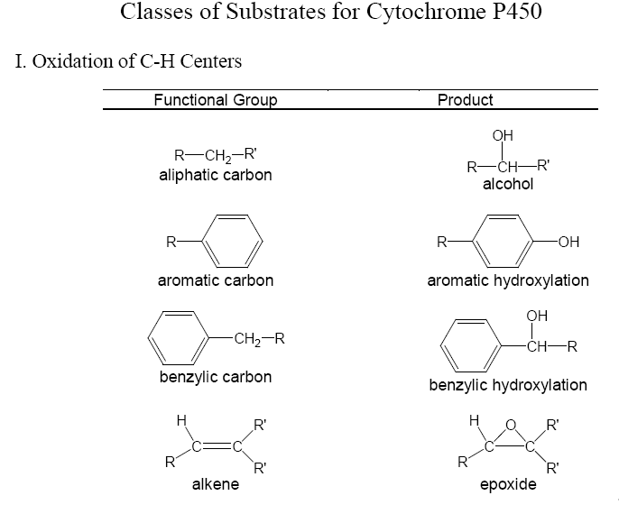

Slide 34
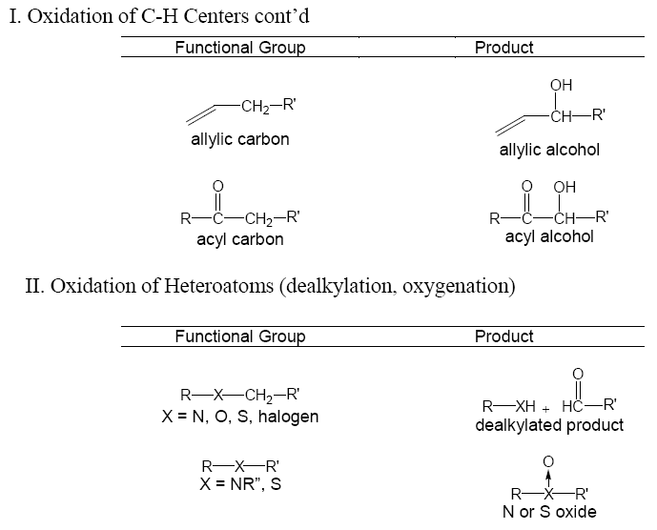

Slide 35
Other enzymes involved in phase 1
Alcohol dehydrogenase
Aldehyde dehydrogenase
Azo reductors
Nitro reductors

Slide 36
(Synthetic)Phase 2
Anabolic in nature
Addition of a macromolecule to the drug or its phase 1 metabolite
5 major reactions in this phase
Glucoronide formation
Conjugation with a sulphide
Acetylation
Methylation
Conjugation with a gluthathione
Conjugation with a glycine

Slide 37
Conjugates are highly polar and generally biologically inactive.
Conjugates are rapidly cleared in urine
High mol. wt conjugates are often excreted in the bile.

Slide 38
Glucoronide Formation
Conjugating molecule - Uridine-diphosphoglucoronic acid
Enzyme - Glucoronyl transferase
Substrates - phenols, alcohols, caboxylic acids, amino or sulphurhydryl groups
End result - Increase in Mw of drugs, therefore facilitates elimination.

Slide 39
Methylation
Conjugating molecule - S-adenosylmethionine
Enzyme - Methyl transferase
Substrates - phenols, alcohols,
End result - Increase in Mw of drugs, therefore facilitates excretion

Slide 40
Conjugation with a gluthathione
Conjugating molecule - S-adenosylmethionine
Enzyme - Gluthathione -S-transferase
Substrates - phenols, alcohols,
End result - Mecarptopuric acid, Increase in Mw of drugs, therefore facilitates excretion.

Slide 41
Conjugation with a glycine
Requires coenzyme A
Conjugating molecle is a glycine

Slide 42
Factors affecting drug metabolisn
Genetic factors
Other drugs e.g. Cimetidine / Ciproxen
Smoking
Enzyme induction/inhibition(CYP450/others)
Some foods
Liver disease
Age

Slide 43
First Pass (Presystemic) Metabolism
Metabolism of orally administered drugs in a single passage thru the gut wall and the liver. This metabolism occurs before passage into the circulation.
A drug given via the oral route may be extensively metabolized by the liver before reaching the systemic circulation.
The same drug—given IV—bypasses the liver, preventing the first-pass effect from taking place, and more drug reaches the circulation.
Eg. of Drugs for which first-pass elimination is significant – Isosorbide dinitrate, Propranolol etc.
First pass elimination is reduced in severe hepatic cirrhosis

Slide 44
Excretion of Drugs
The process by which drug is removed from the body.
Parent drug or its metabolite may be excreted
Excretion primarily occurs via the Kidneys
N.B. Patients with renal disease (elderly/heart disease) may require lower doses as the drug will be retained for longer.
Others organs of excretion are
via the gut (faeces),
the skin (sweat),
the lungs (breath
Breast milk
Saliva

Slide 45
Renal Excretion
Lipid soluble drugs are not completely excreted by the kidney
Biotransformation required to increase their water solubility and excretion
Three processes
Glomerular filtration
Passive Tubular reabsorption
Active Tubular Secretion

Slide 46
Glomerular Filtration
amount filtered thru glomerulus depends on
Glomerular filtration rate
Size of Drug molecules
Concentration in plasma
One-fifth of plasma reaching glomerulus is filtered through pores in the glomerulus.
Filters most drugs except very high Mw or those bound to plasma proteins.

Slide 47
Active Tubular Secretion
As filtrate moves along tubules, some drug is actively secreted from the peritubular capillaries into the kidney tubules.
In proximal convoluted tubules
Active process
High Mw
Similar to endogenous compounds secreted in urine

Slide 48
Passive Tubular Reabsorption
As filtrate moves along tubules, some drug is passively reabsorbed from the kidney tubules into the peritubular capillaries .
In Distal convoluted tubules
Passive process
Lipid soluble and unionized at filtrate PH

Slide 49
Biliary Excretion
High Mw
Extremely polar
Similar structure to substances secreted in the bile
Active process
Certain drugs that are conjugated without undergoing phase I metabolism are are secreted in the bile and undergo enterohepatic circulation

Slide 50
Enterohepatic circulation
Drugs conjugated and secreted in the bile
Bile passes into the intestine, carrying the drug
Free drug is broken from conjugate by enzymes in the intestine
Free drug reabsorbed thru GIT mucosa, back into circulation
Conjugated again, delivered to bile, back to intestine………….

Slide 51
Excretion Through the lungs
Any gaseous metabolite
Eg. Dimethyl sulphoxide metabolised to Sulphurdioxide

Slide 52
Excretion Through the Sweat, saliva, breast milk
Highly lipid soluble drugs or metabolites can diffuse into the compartments in which these fluids are stored

Slide 53
Clearance
Definition
Volume of plasma that is cleared of a drug per unit time.
Renal clearance = Conc of Drug in urine X Rate of urine formation
Conc of drug in plasma
Clearance ratio = Renal clearance
GFR

Slide 54
Pharmacokinetic parameters
Bioavailability: the proportion of an administered dose that reaches the systemic circulation, usually expressed as a percentage.
IV drugs =100%, other routes of administration < 100%. are affected by incomplete absorption or metabolism
In some exercises the fraction of the dose that is absorbed (F) must be calculated.
F = Dose IV X AUC oral
AUC IV Dose oral
or
F = AUC oral
AUC IV if oral and IV doses are the same

Slide 55
Volume of Distribution: the amount of drug in the body divided by the plasma concentration, having units of volume (L) which can be corrected for bodyweight (l/kg
The volume of distribution of the drug can be calculated using the equation:
Vd = t½ x CL/0.693
Units for volume of distribution are litres.

Slide 56
Clearance: the rate of drug elimination divided by the plasma concentration, units of flow is (ml/min) which can be corrected for bodyweight (ml/min/kg).
It provides a measure of the body’s ability to eliminate the drug substance from the plasma, by either metabolism or excretion,
The clearance of the drug can be calculated using the equation:
CL = F x dose/AUC
where F = the fraction of the dose absorbed.
For intravenous dosage F = 1.

